Slide 1





Evaluation of PRECOM : a new predictive algorithm for awakening in comatose ICU patients
"Intelligent Brain Predictions"
Team 6: Hemostasis, Thrombo-Inflammation & Neurorepair
Sahar Chakroun, David Holcman, Romain Sonneville, Nathalie Kubis
Clinical physiology and functional explorations department
Lariboisière Hospital , Paris. France
24-28 October 2022
ISRC-CN3 Autumn School 2022

Slide 2

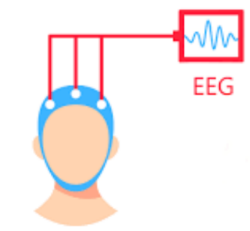
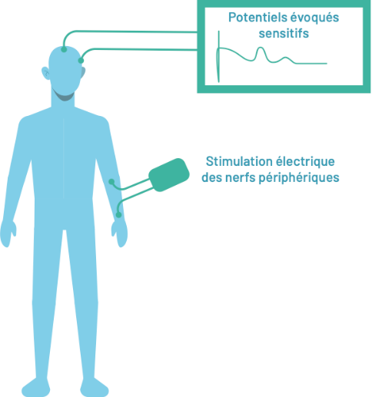
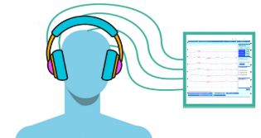
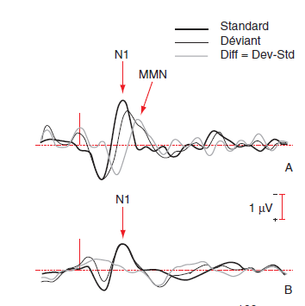
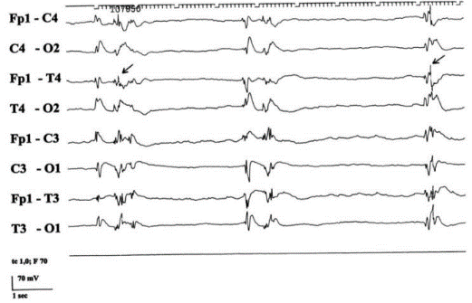
Post-anoxic coma: what prognosis ?
Absence of pupillary and/or corneal reflexes >= 72h
Bilaterally absent cortical somatosensory-evoked potentials (N20)
Higly malignant electroencephalography > 24h
NSE > 60 ug/l at 48 h and/or 72 h
Myoclonic stutus > 72 h
Extensive and diffuse anoxic damage in TDM / MRI
2021 guidelines of European Resuscitation Council
AEP
SEP
Lancet Neurol 2016
Lancet Neurol 2016

Slide 3

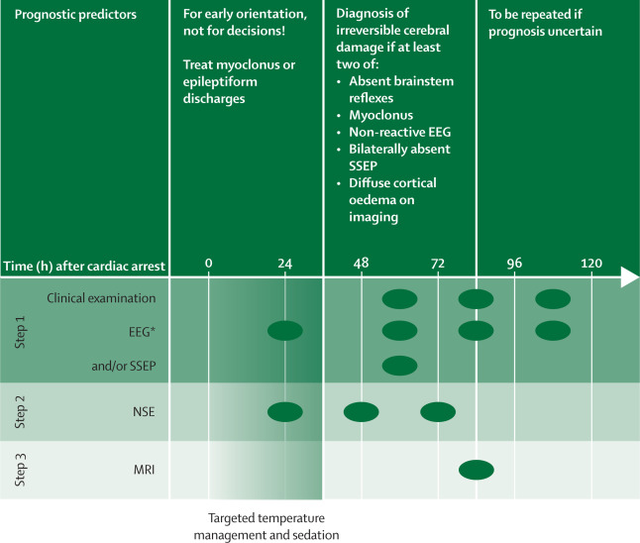
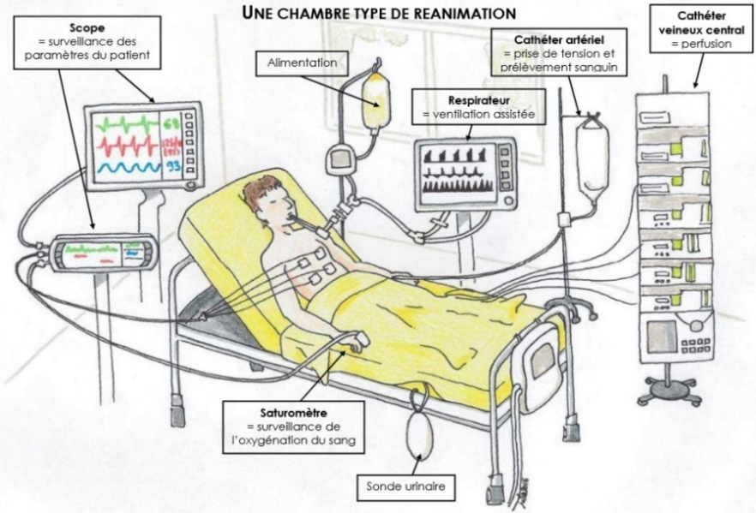
Issues
Very good
Very poor
Artefacts
Lack of neurophysiologists
Lancet Neurol 2016

Slide 4
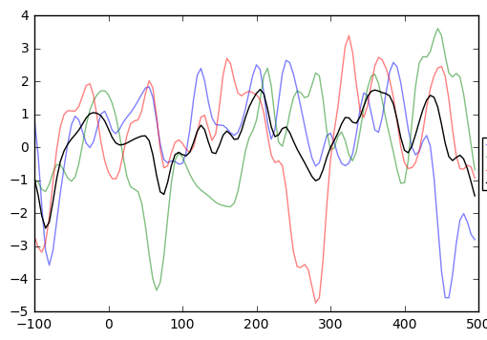
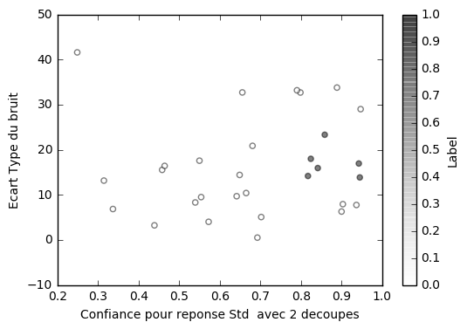
Objectif: to develop a new tool : PRECOM toward a decision making algorithm
Poor prognosis : 23/29
Good prognosis : 6/29
PRECOM : AI algorithm based on mathematical caracterization of cerbral signals after standard and deviants auditives stimulations
Nbre of extreme points
Using a one electrode : Cz
Signal variance
Patent FR 1852473 (22 mars 2018)

Slide 5
2nd phase study
To evaluate PRECOM for both awakening prediction and neurological prognosis at 3 and 6 months in post-anoxic coma patients.
Regional multicenter prospective cohort study (6 centers)
→ 100 patients over 30 months
Procedures | D3-D7 | D10-D14 | M3 | M6
Pre-inclusion data collection, Patient Information | X
Biology markers | X
Clinical data , Electrophysiology : PRECOM | X | X
Evaluation criteria : awakening, functional scores |  |  | X | X
Expected results
Have a new prognostic tool, easy to perform and available in resuscitation units.

